Slide 1
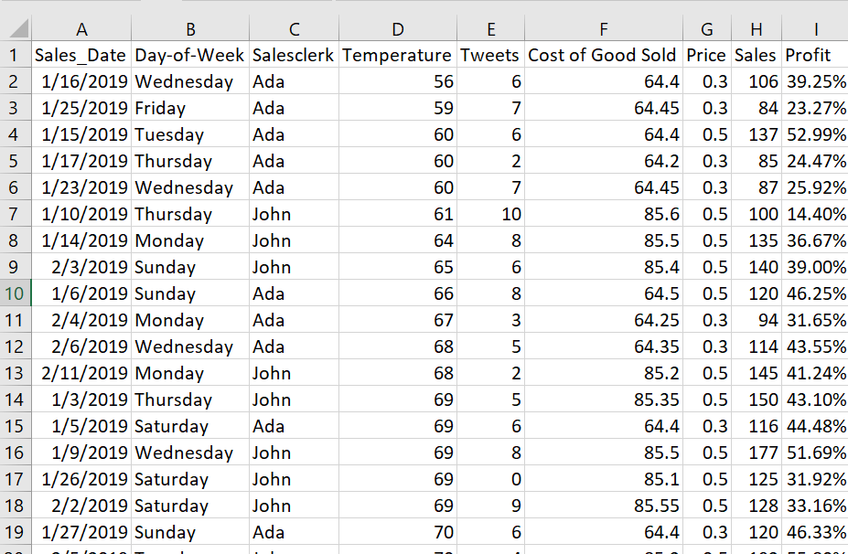




Story Telling: Fire or Keep Decision
The BOSS
You are fired!
Mr. Mookie Conster
Your boss, Mr. Mookie Conster, fired Ada because based on a sales dataset from 01 Jan – 19 Feb 2019, she is a terrible salesclerk compared to John.
FIRED

Slide 2

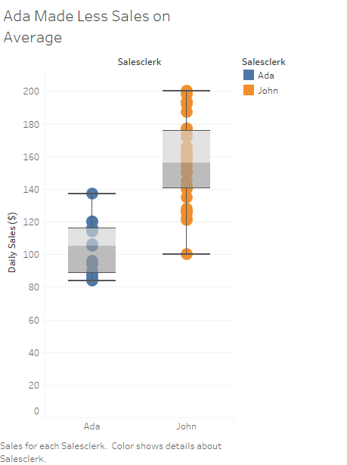
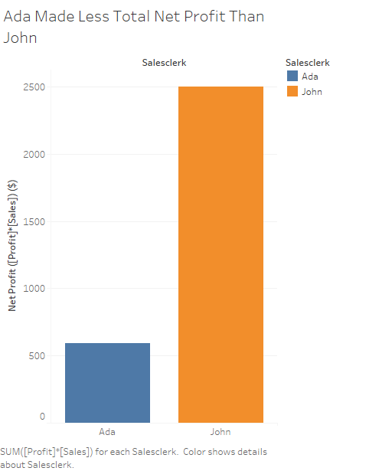
Story Telling: Fire or Keep Decision
Within the 50 days in the dataset from 01 Jan – 19 Feb 2021:
: “Why?”
1)
2)
: “2 reasons”

Slide 3


Story Telling: Why Was Ada Wrongfully Terminated?
What should I do?
You think Mr. Mookie wrongfully terminated Ada. Using the same dataset, you try to prove that the comparisons were unfair, and Ada deserves a second chance!

Slide 4

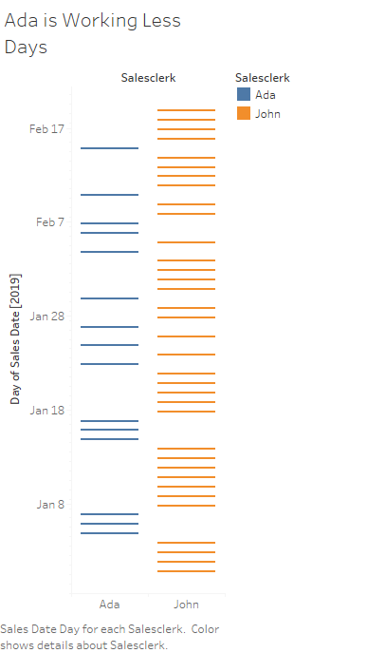
Story Telling: Why Was Ada Wrongfully Terminated?
1) Work Day Inequality
Within the 50 days, Ada only worked 15 days, while John worked the other 45, including on Valentine’s and President’s Day. You have questions:
Why were shifts not equally assigned?
Are they fighting for working days?
How can we fairly compare Ada vs John?

Slide 5
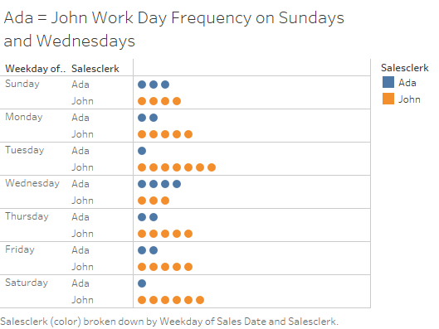
Story Telling: Why Was Ada Wrongfully Terminated?
1) Work Day Inequality
To try to fairly compare their performances, you place more weight on days where Ada worked almost as frequent as John – Sundays and Wednesdays (highlighted in red).
Additionally, you also suggest that her performance is tracked over a longer timespan, since a decision made based from 15/50 days does not do her justice.

Slide 6
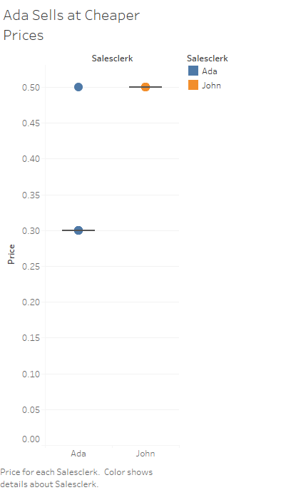
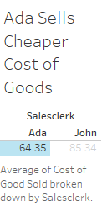
Story Telling: Why Was Ada Wrongfully Terminated?
2) Product and Price Differences
b)
It is also unfair to compare purely in terms of revenue ($) earned, because a) John sells higher cost of goods at a b) higher price. You have questions:
Do they have equal access to resources?
Is Ada free to set her own prices?
Is her business strategy different from John?
Price ($)
a)
Cost ($)

Slide 7
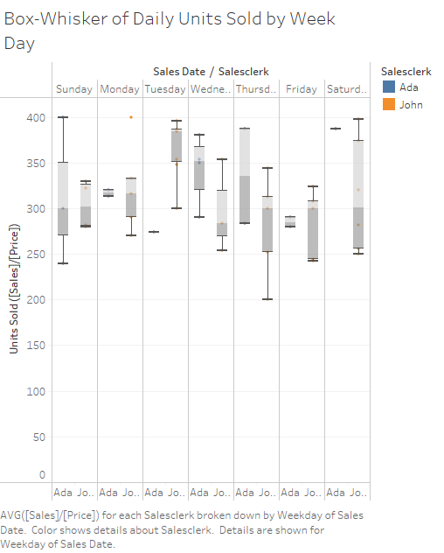
Story Telling: Why Was Ada Wrongfully Terminated?
2) Product and Price Differences
Instead of comparing revenue ($), you want to normalize for different cost of good and prices, you suggest another metric: Number of units sold [Sales]/[Price].
John earned more profit ($), but on a daily average, Ada sold more units than John on Sundays, Wednesdays, Thursdays, and Saturdays, which is not terrible!

Slide 8
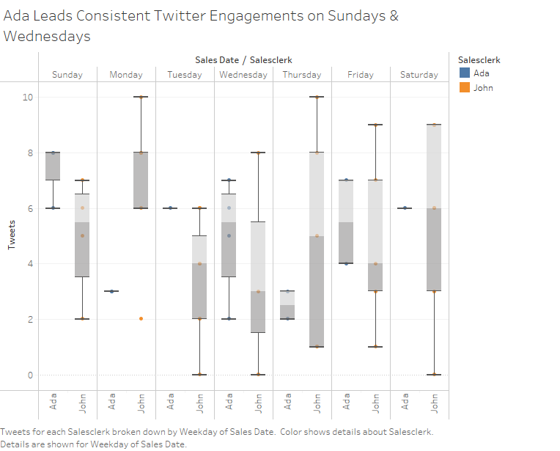
Story Telling: Why Was Ada Wrongfully Terminated?
3) Sales Marketing
Since marketing is another aspect sales, Another metric worth comparing is marketing tweets [Tweets].
On a daily average basis, given equal working day frequency (Sundays and Wednesdays), Ada tweeted more than John to attract new customers.
The tighter box whisker plots also indicate that Ada is more consistent than John. John even had days where he did not tweet at all!

Slide 9
Story Telling: Summary
Visualization 1- Fire of Keep Decision
Your boss, Mr. Mookie Conster had to manage your associates Ada and John for the 3 months you were on vacation. In your absence, he fired Ada because based on a sales dataset from 01 Jan – 19 Feb 2019, she is a terrible salesclerk compared to John. Within those 50 days, 1) Ada, on a daily average, made less revenue AVG[Sales] than John and 2) Ada made less total net profit SUM([Profit]*[Sales]) than John.
Visualization 2- Why Ada was wrongfully terminated?
You think Ada was wrongfully terminated because the comparisons were unfair, and Ada deserves a second chance!
First, there are unequal work days between Ada and John, where they worked 15 and 45 days respectively. Therefore, you try to fairly compare Ada and John on week days where they work at the same frequency – Sundays and Wednesdays. You also suggest that Ada’s performance needs to be tracked over a longer time span.
Second, Mr. Mookies’ visualizations does not take into account product and price differences between Ada & John. It is unfair to compare purely in terms of revenue since John sells at a higher cost of goods at a higher price. Focusing on units sold, you notice that Ada outperformed John on 4/7 week days, including Sundays and Wednesdays.
Lastly, is comparing effort in marketing their products. Ada tweeted more than John on Wednesdays and Sundays. The box and whisker plots also suggest that Ada is more consistent with her tweets, while John has days where he did on tweet at all.
In conclusion, normalizing for work day frequency, the data suggest that Ada performed better, if not, equally, compared to John, in terms of unit sold and marketing. Regardless, a more comprehensive evaluation is needed on a larger timeframe. With that second chance, Ada deserves a second chance to prove herself with the same product, same profit margin, and same number of working days as John.

